Slide 1
Scots Language
*
1

Slide 2
What is Scots?
Scots is the traditional Germanic language of Lowland Scotland and the Northern Isles. It is also used in parts of Ulster.
*
2

Slide 3
Origins
Scots is descended from Northumbrian Old English, brought to the south of what is now Scotland from around the seventh century by the Angles - one of the Germanic-speaking peoples who began to arrive in the British Isles in the fifth century.
English is also descended from the language of these peoples. So they are sister languages.
*
3
Notes:
This Powerpoint presentation was prepared by Liz Niven with the assistance of The Scots Language Centre and Scottish Language Dictionaries.
For additional information and resources see
www.lizniven.com
www.scotslanguage.com (Scots Language Centre)
www.scotsdictionaries.org.uk (Scottish Language Dictionaries)
www.scuilwab.org.uk (Scottish Language Dictionaries’ Schools’ site)
www.dsl.ac.uk (The Dictionary of the Scots Language)
This powerpoint is intended to enable teacher-led CPD sessions.
Contact Liz Niven, SLD or SLC if you would like a facilitator to support delivery.
We would be happy to provide powerpoints pitched at different levels or reflecting specialist interests in the language. For more information contact elaine.webster@scotsdictionaries.org.uk.
3

Slide 4
`
By the 11th century, Gaelic, descended from the Celtic language brought over from the north of Ireland by the original Scots, had become the dominant language in most of the emerging kingdom. At this point, there was a great influx of people from the North of England whose language had been heavily influenced by the Vikings.
*
4

Slide 5
Enriched with French, Latin, Gaelic and Flemish loanwords, this was to become the Scots language.
As time went by, Scots and English went their separate ways. The north of England looked to the south as its model and Scotland developed its own rich literary culture.
*
5

Slide 6
Scots as a national language
In the 14th century, Scottish Kings and Queens spoke Scots as well as other European languages.
By the early 16th century, Scots, as it was now called, was well on the way to becoming an all-purpose national language, just as English was developing south of the border.
*
6

Slide 7
What happened to it?
After the Scottish Reformation (1560), the Union of the Crowns (1603) and the Union of the Parliaments (1707), southern English gradually became the language of most formal speech and writing and Scots came to be regarded as a 'group of dialects' rather than a 'language'. It continued, however, to be the everyday medium of communication for the vast majority of Lowland Scots but it lost prestige.
*
7

Slide 8
There was a revival with the poetry of Robert Fergusson and Robert Burns. Sir Walter Scott wrote such pieces as Wandering Willie’s Tale and in the early 20th century, poets like Hugh MacDiarmid actively sought to promote Scots.
From the late 20th century onwards, there has been a flood-tide of talented new writers. Literature in Scots now has international recognition.
*
8

Slide 9
The European Charter for Regional or Minority Languages is intended to ensure, as far as is reasonably possible, that regional or minority languages are used in education and in the media. The UK Government signed the Charter in 2000 and ratified it in 2001 in respect of Welsh, Scots and Gaelic in Scotland and Ulster-Scots and Irish in Northern Ireland. Manx Gaelic and Cornish were subsequently incorporated.
*
9

Slide 10
What is Scots?
Like any language, Scots has:
its own vocabulary,
its own grammar and
its own idiomatic phrases.
(It also shares many words with English)
*
10
Notes:
See www.tomleonard.co.uk
10

Slide 11
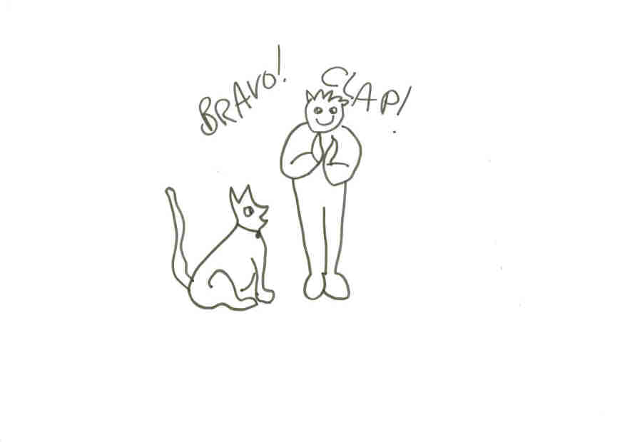
Clap ma dug
*
11
Notes:
11

Slide 12
The Scottish – English Continuum
Scottish speakers use a mixture of Scots and English, with some using mostly Scots and others mostly English.
The language exists as part of a continuum with Scottish Standard English.
When linguists talk about Scottish language they are including everything on this continuum.
*
12

Slide 13
Scots Vocabulary
Sometimes we use Scots words without realising it.
messages - errands
pinkie – little finger
pieces - sandwiches
swither – vacillate
*
13

Slide 14
Scots Vocabulary
Other words are very obviously Scots.
ken – know
ay – yes
lugs – ears
heid – head
stooshie –fuss
*
14

Slide 15
Scots Grammar: some examples
The use of the definite article and possessive pronoun ('I have the flu and I'm away to my bed' rather than 'I have flu and I am going to bed') are typically Scots. Other features are the use of 'yous' as a second person plural pronoun, the extra demonstrative yon (or thon) and plurals such as een. Yet these are often regarded as 'bad grammar' rather than examples of legitimate Scots.
*
15

Slide 16
Slang
Some people confuse Scots with slang.
Slang changes all the time. What’s trendy one day can become old fashioned the next. Slang is usually very cool.
Scots has been around for centuries and has a huge amount of literature written in it. It has got formal styles and its own slang within it.
Rhyming slang: Are you corned beef?
*
16
Notes:
Published in The Kist (2001) Learning and Teaching Scotland
16

Slide 17
Scots & Other Languages Scots and Germanic Languages
Scots, German, Dutch, English and the Scandinavian languages are all related. They belong to the Germanic family of languages.
We can see this when we compare words like kirk (Scots), kirke (Norwegian), kerk (Dutch), kirche (German), church (English).
*
17

Slide 18
Scots & French
Many of our Scots words come from French, especially words connected with food.
ashet (assiette)
gigot (gigot – a leg of lamb)
braw (brave)
dinna fash yersel (fâcher)
a golf caddie (cadet)
*
18

Slide 19
Scots & the Vikings
reek, big (build), gate (road), till (to)
birk, breeks (k/ch)
brig, rig (-g, -dge)
*
19

Slide 20
Scots & the Low Countries
craig (neck)
loun (boy)
redd up (tidy up)
scone
gowf (golf)
*
20

Slide 21
Scots and Latin
Most of the Latin loans come from law and education, although classical literature was also very influential.
Sederunt, sine die, homulgate
dominie, dux
*
21

Slide 22
Scots and Gaelic
Early period borrowings:
corrie, ben, strath
cateran, ingle, tocher
Later borrowings:
claymore, fillebeg, sgian dhu
*
22

Slide 23
Scots as National language
Kings and Queens spoke Scots.
In 1603 King James VI of Scots became King James I of England as well.
He went to London and all the things he wrote in Scots were printed in English.
*
23

Slide 24
Scots parliament
In 1707 The Union of Parliaments joined Scotland and England and the Scottish Parliament stopped meeting. It didn’t meet again until Holyrood opened in 1999.
Gradually, over all these years from 1707 onwards, people began to think that speaking English was better than speaking Scots. Even the Bible was printed in English instead of Scots.
*
24

Slide 25
Kirk & Bible
The Geneva Bible was translated from Latin into English and not into Scots.
Scottish people wanted to learn English to read the Bible.
Now God, the King and the Parliament all spoke in English. Folk decided it must be important!
*
25
Notes:
These loans go back to the Old English period of the Viking settlements. Because Old Norse and Old English were very similar, it was easy to borrow words. Most of the loan words are simple, everyday words borrowed through conversation. Some interesting things happened to pronunciation as we can see when we compare breeks and breeches, brigs and bridges. In Old English, there were two words for ‘child’. These were ‘cild’ and ‘bearn’. Old Norse had the word ‘barn’. So, in Scots, we keep ‘bairn’ because it was reinforced by Old Norse, but it has been lost in the south of England.
In Orkney, Shetland and the very North of Scotland, there was direct influence from Norwegian. Orkney and Shetland were only ceded to Scotland in the reign of James III of Scotland by Denmark in 1468 .
25

Slide 26
Official Status
Curriculum for Excellence
While respecting different perspectives on Scots, we are primarily concerned with the practicalities of raising its profile in classrooms. We hope that by capturing the interest of pupils in the linguistic diversity of Scotland, they will eventually be able to make informed judgments for themselves.
*
26
Notes:
There were many Flemish craftsmen in the early Scottish burghs and Scotland maintained contact with the Low Countries through trade, fishing and military service.
26

Slide 27
Dialect variation
Scots language consists of different dialects:
Shetland and Orkney
Northern
North East
Tayside
Central: East Central, West Central,
Borders
South West
Ulster
*
27

Slide 28
Shetlandic
Sometimes I tink whin da Loard med da aert, an He got it aa pitten tagidder, fan He still hed a nev-foo a clippins left ower, trimmed aff o dis place or da tidder, An He hedna da hert ta baal dem awa, For dey lookit dat boannie an rare, Sae He fashioned da Isles fae da ends o da aert, An med aa-body fin at hame dere. Dey lichted fae aa wye, some jost for a start, While some bed ta dell riggs an saa coarn, An wi siccs gret gadderie a fok fae aa ower, An entirely new language wis baorn. A language o wirds aften hard tae translate, An we manna belittle or bo, For every country is prood o da wye at hit spaeks, An we sood be prood a wirs to. Rhoda Bulter
*
28

Slide 29
Galloway
A Christmas Poem
A caald winter's nicht
Starn heich in the lift
A lass wi a bairnie
Ahint a snaa drift
Come in through the byre
Step ower the straw
Draw ben tae the fire
Afore the day daw.
The bairnies will sleep
By the peat's puttrin flame
Oor waarmin place, lassie,
This nicht is your hame.
Come mornin the snaa
Showed nae fitprints at aa
Tho the lass wi the bairnie
Had stolen awaa.
An we mynded anither
A lang while afore
Wi a bairn in her airms
An the beasts roun the door.
Josephine Neill
*
29
Notes:
To compare King James’s own Scots with the English of his publishers see www.scuilwab.org.uk
29

Slide 30
Glaswegian
The Dropout
Scrimpt nscript furryi
urryi grateful
no wan bit.
speylt useless yi urr
twisted izza coarkscrew
cawz rowz inan empty hoose
yir faithir nivirid yoor chance
pick n choozyir joab
a steady pey
well jis take a lookit yirsell
naithur work nur wahnt
aw aye
yir clivir
damn clivir
but yi huvny a clue whut yir dayn.
Tom Leonard
*
30

